Slide 1
FamilyCircle
Providing peace of mind

Slide 2
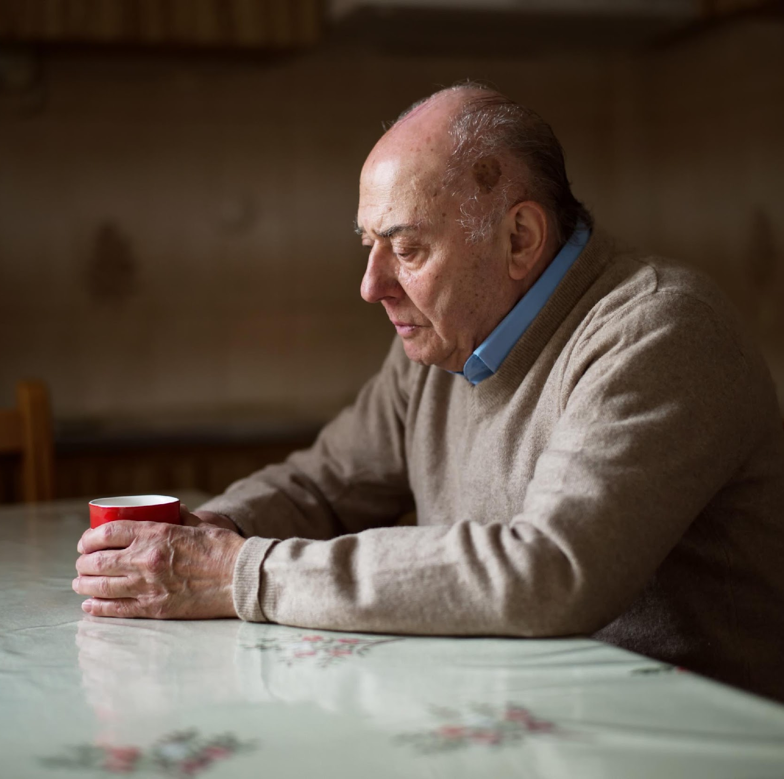
Meet Jonathan
Retired and living alone
Aged 65+
Needs to be able to call for help when required
Peace of mind

Slide 3
Initial problem statement & hypothesis
Problem Statement:
Elderly people who live alone need a way to contact their carer/guardian when there has been an emergency and are physically unable to get to the telephone.
Because…it will provide them with ability to call for the help when it is needed.
Hypothesis:
We believe that by providing an automated handsfree method of calling for help in an emergency we can solve this problem.
We will test this by measuring the number of signups on a landing page and google ad results

Slide 4
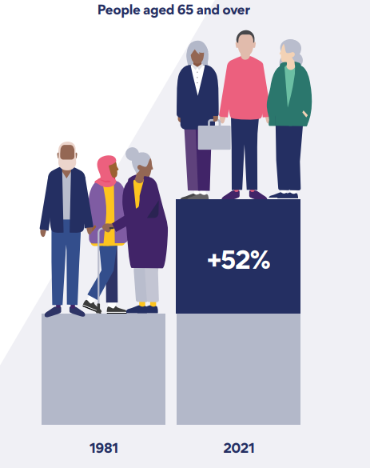



Target Market
TAM: Currently 11 Million people aged 65+ in the UK, expected to grow to 17 Million in 2034
SAM: More that 4.3 Million aged 45-74 live alone in the UK, expected to grow to 7 million in 2034
SOM: 1 Million persons aged 65+ in the UK who live alone in their own homes.
Source: https://www.ageuk.org.uk/information-advice/health-wellbeing/loneliness/

Slide 5
Problems Identified
Interviewed 5 elderly persons who live alone
Interviewed 4 guardians / children

Slide 6
Insights
Concerns about their privacy
Aware of risk to life
Regular Check-ups
Companionship
Loneliness
Our customer might be the guardian
“I am aware of risk to life and eager to find a lasting solution that will not be tasking on anyone.”
- John Barnes
Link to Affinity Map

Slide 7
Revised problem statement & hypothesis
Problem Statement:
Guardians of elderly persons who live alone in their own homes need a way to know that their parent/ward can call for help when there has been an emergency and are physically unable to get to the telephone.
Because…it will provide them peace of mind
Hypothesis:
We believe that by providing an automated handsfree method of calling for help in an emergency we can solve this problem and provide both guardians and their parent/ward with peace of mind.

Slide 8
Competitor Analysis
 | FamilyCircle | Traditional Affirmative action devices | DIY Installations | IOT
Alert Auto Trigger | Yes | No | No | No
Fall detection | Yes | Yes | No | Yes
Power Supply | Multi | Battery | Multi | Battery
Auto Check Up Call | Yes | No | Yes | No
Privacy | Yes | Yes | No | Yes

Slide 9
Prioritisation
Priority | Feature | Level of Effort (Pebble, rock, boulder) | MoSCow (Must, should, could, won’t) | Customer Value | Score ( Customer Value / Effort)
1 | Ability to automatically trigger call to guardian in case of significant deviation from typical pattern of activities so that guardian can initiate agreed protocol | 4 | Must | 5 | 1.25
2 | Ability to automatically trigger call to emergency services so that in the case of non - responsiveness, emergency services can attend | 4 | Must | 4 | 1.0
3 | Ability to measure general well being throughout the day so that both the elderly person and their guardian will know the state of health | 3 | Should | 2 | 0.7
4 | Ability to generate auto caller to check in on the individual at specified intervals, so that the elderly person can provide real time status of their wellbeing to their guardians. | 4 | Could | 2 | 0.5
5 | Ability to provide well being chart so that guardian can see trend over time and there by take necessary actions or providing peace of mind. | 4 | Could | 2 | 0.5
6

Slide 10
Objectives:
This will help us learn very quickly how this product will be used and how often and gain a sense of the value it adds to the lives of our users.
.
Roadmap
MVP
Next
Future
Roadmap
Monitor general well being throughout the day
Automatically trigger call to emergency services.
Automatically trigger call to guardian
Generate auto caller to check in on the individual at specified interval.
Wellbeing chart
Planned
Scoped
Not Scoped

Slide 11
Measure of success
Objective | Key Results
Gain market awareness | 100 sign ups in first 30 day 1000 users within 6 Months
Profitability | 200 paying users in 1 year 30% MoM user growth

Slide 12
Proposed solution
IRREGULAR PATTERN OBSERVED?
START
MONITOR ENERGY USAGE
ANALYSE ENERGY USAGE WITH AI /MACHINE LEARNING
NOTIFY GUARDIAN VIA IN APP NOTIFICATION
END
YES
NO
KEEP MONITORING ENERGY USAGE

Slide 13
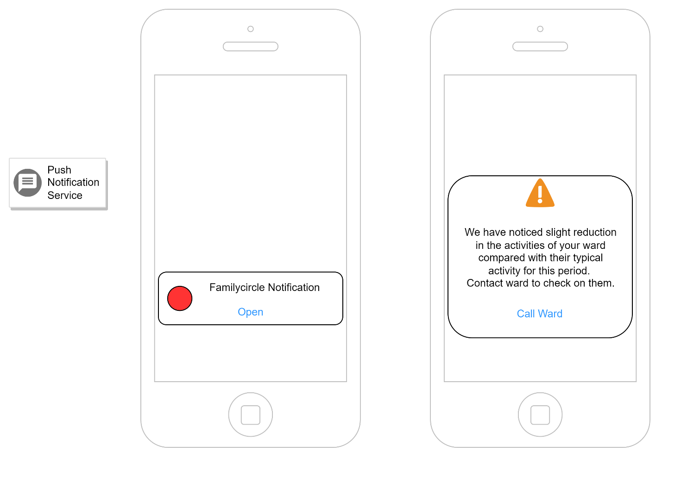
Proposed solution

